Slide 1
Alberta’s Evolving Energy System - Regulating in a Rapidly Changing Landscape
GPAC Presentation
Cal Hill, EVP Strategy & Regulatory
March 24, 2016

Slide 2
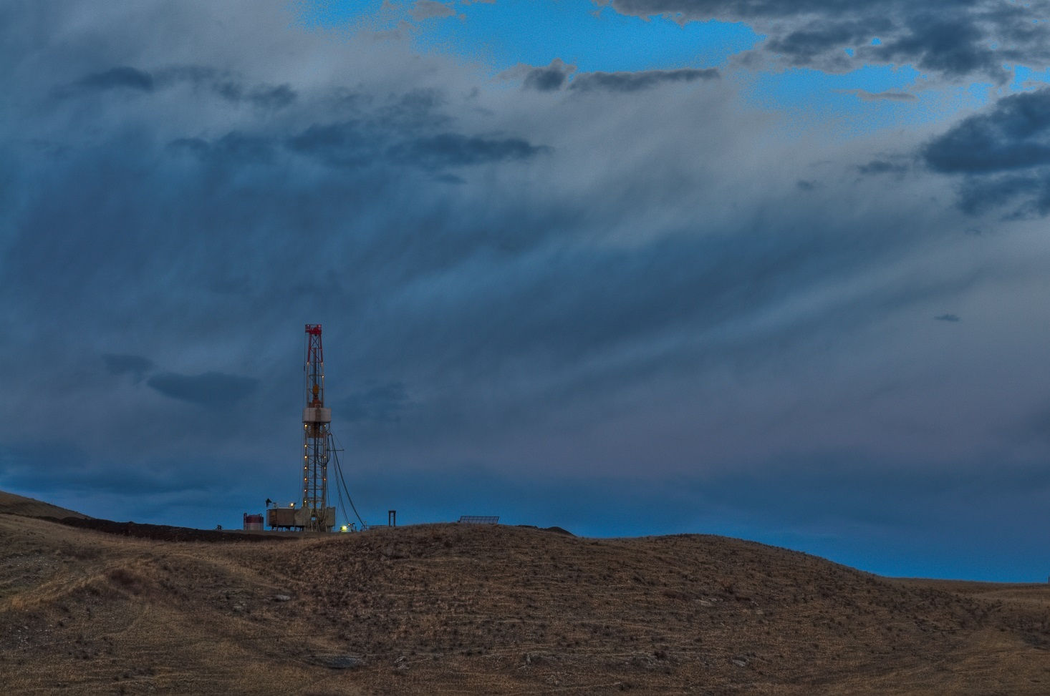
Introduction
About the AER
Where we came from
What has changed
Where we are going
Key Initiatives
Questions

Slide 3
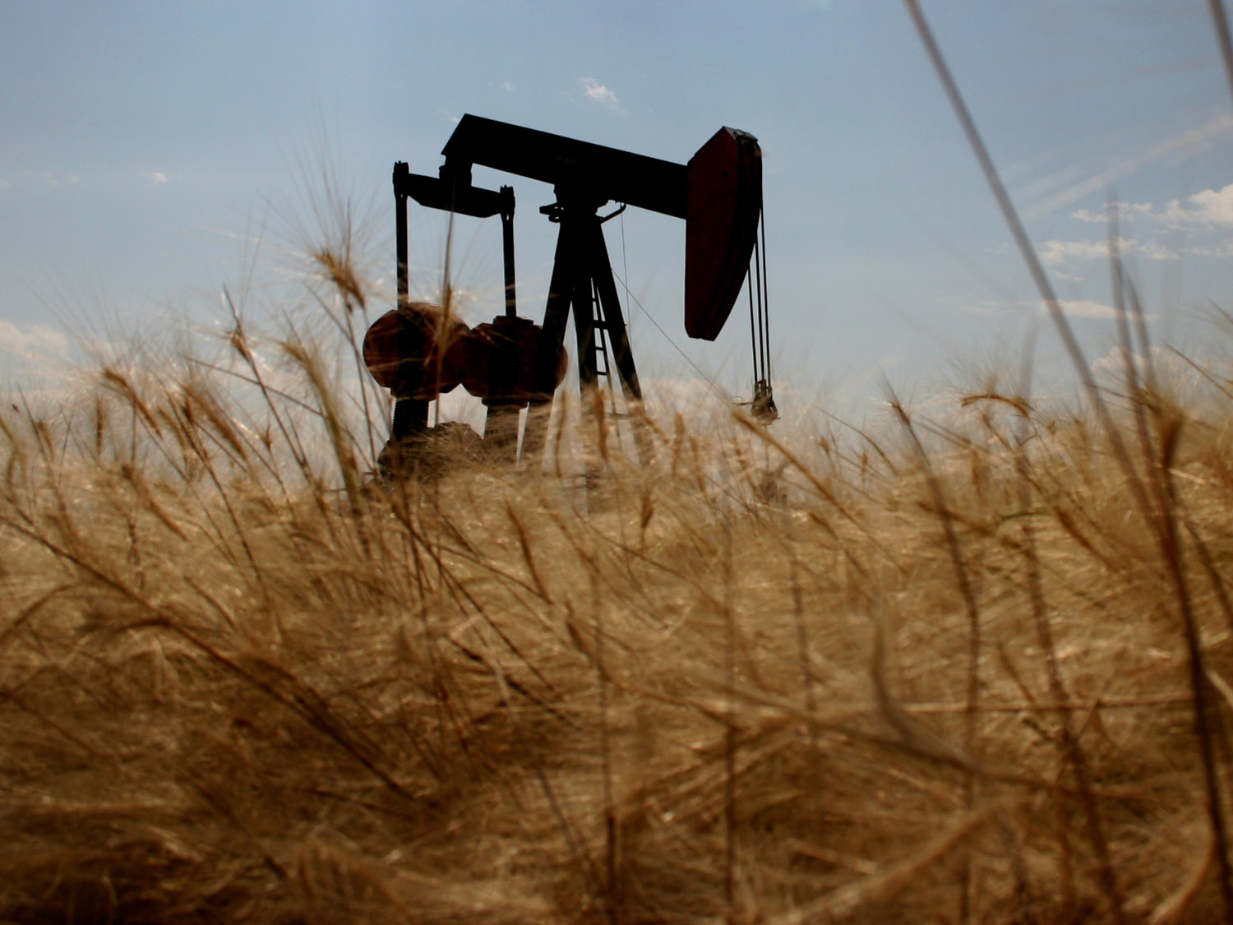
About the AER

Slide 4
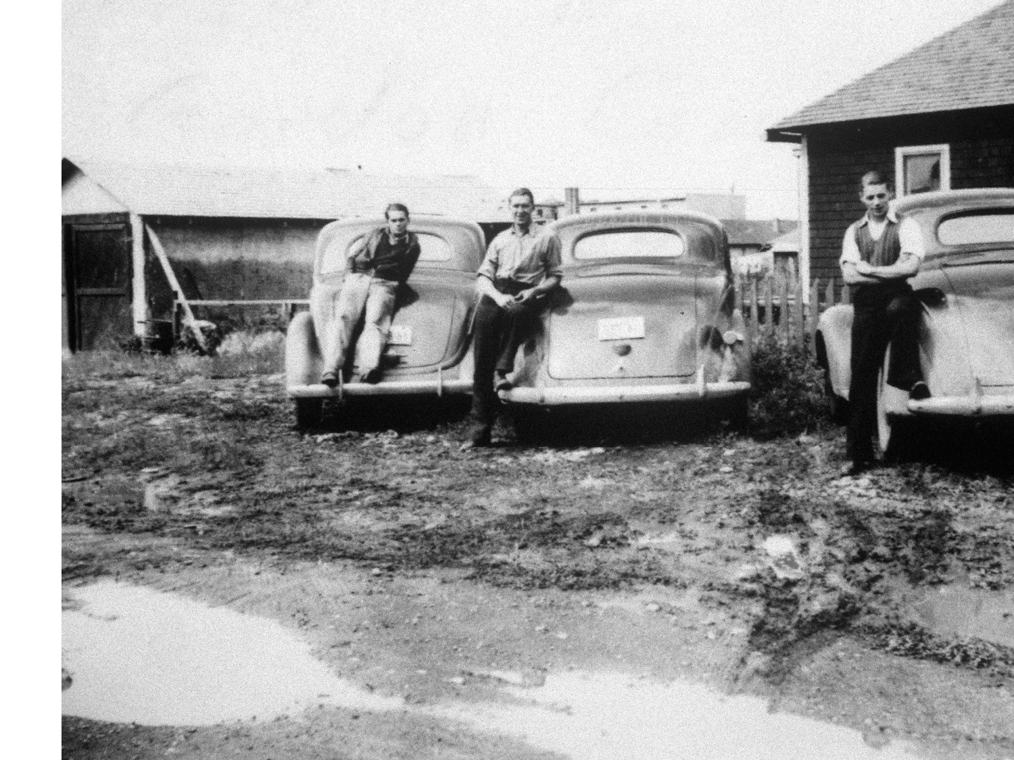
Where we came from
Petroleum & Natural Gas Conservation Board – Field Inspectors

Slide 5
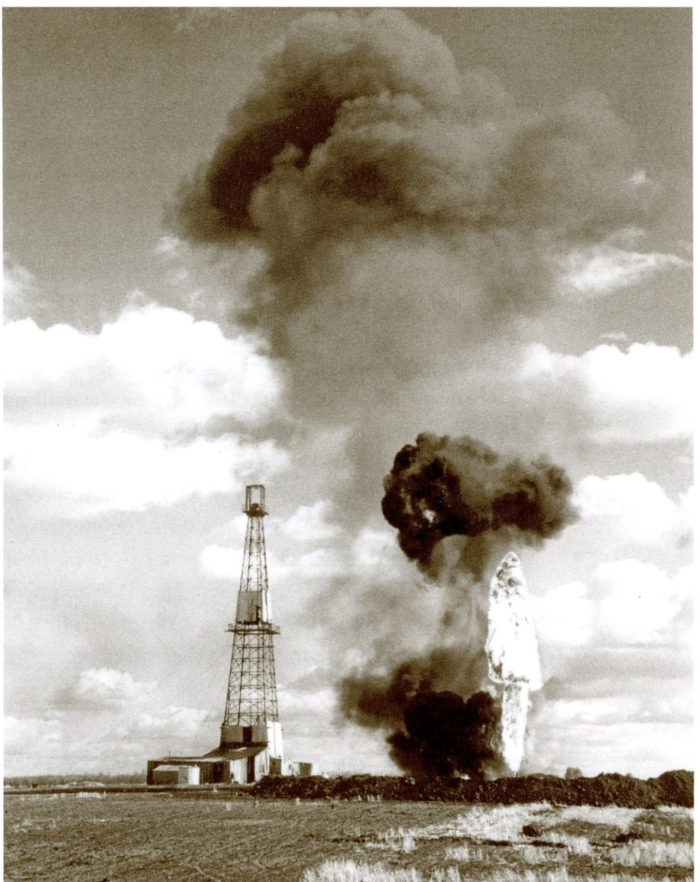
Resource Recovery Optimization
Rule of Capture
Promoted waste
Resource Conservation
loss of reservoir energy & oil recovery
Control waste
excessive drilling
excessive flaring
surface loss & pollution
fire loss & hazard

Slide 6
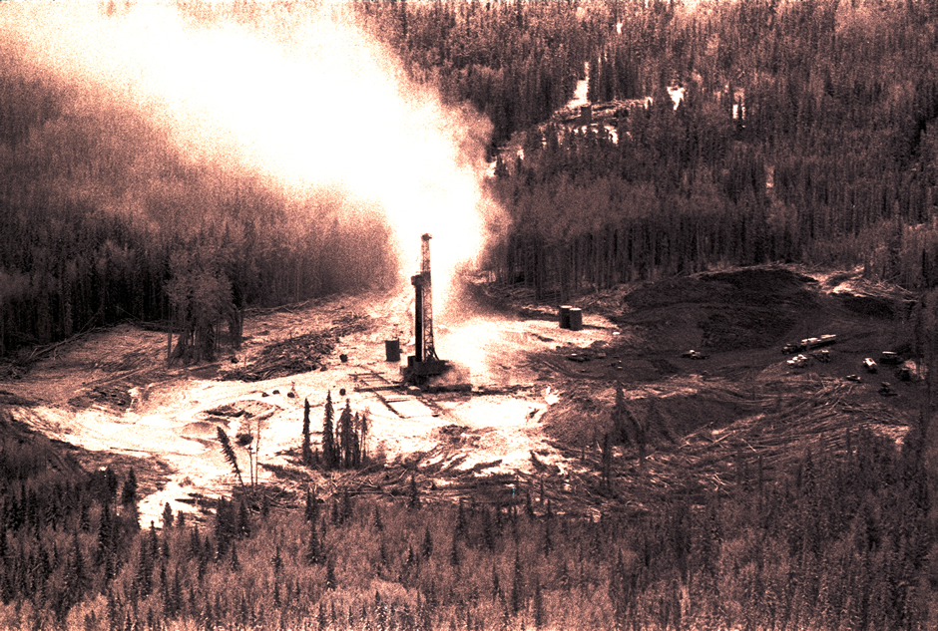
Public Safety
Lodgepole blowout Inquiry
Public Safety and Sour Gas Initiative
Edmonton Journal photo – Provincial Archives of Alberta

Slide 7
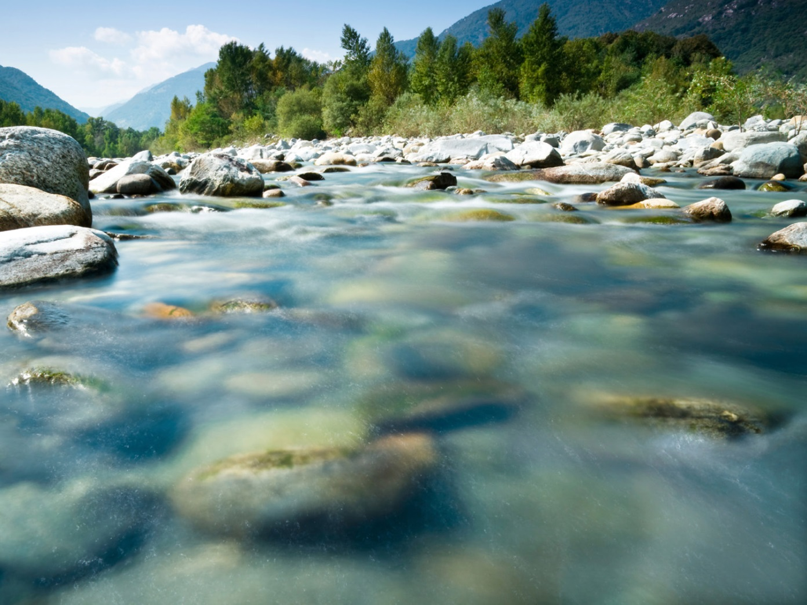
Environment
Expanded mandate in June 2013
Energy aspects of Environmental Protection and Enhancement Act, Water Act, and Public Lands Act

Slide 8
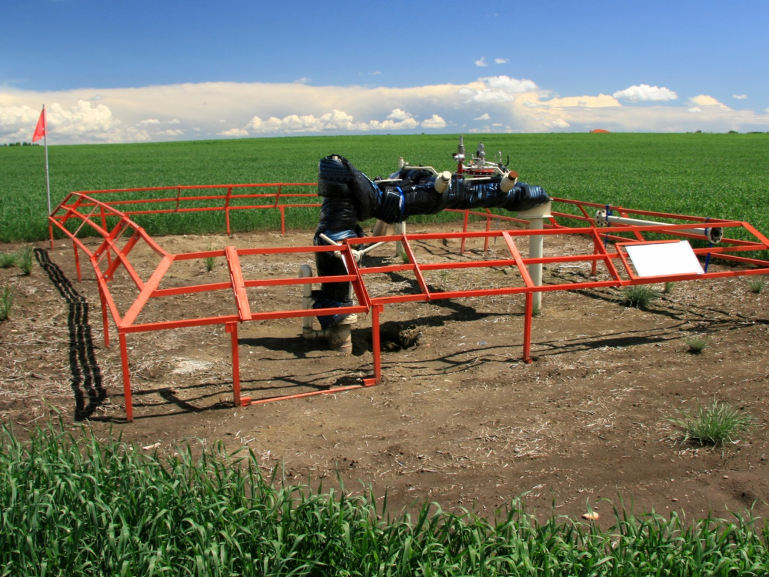
Energy Regulation Pre-2013
Multiple agencies
Based on vertical wells into conventional pools
Prescriptive
Pressure to change

Slide 9
Drivers for change
Technology
How and what energy is being developed
Geographic shift in energy supply/demand
Increasing environmental impacts as landscape becomes busier
Societal expectations
Social
Expectations, involvement, values
Environment
Cumulative
Impacts
Energy (Economics)
Optimize resource recovery

Slide 10
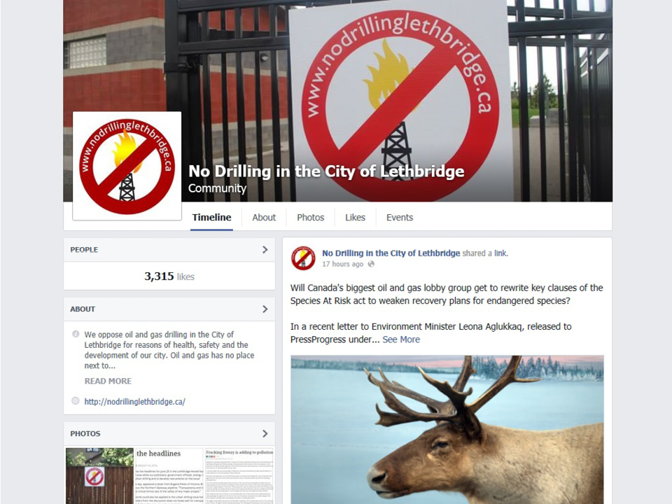
Hot Issues
Climate change – GHGs
Market access
Use of water
Stakeholder participation
Regulatory efficiency
Regulatory effectiveness

Slide 11
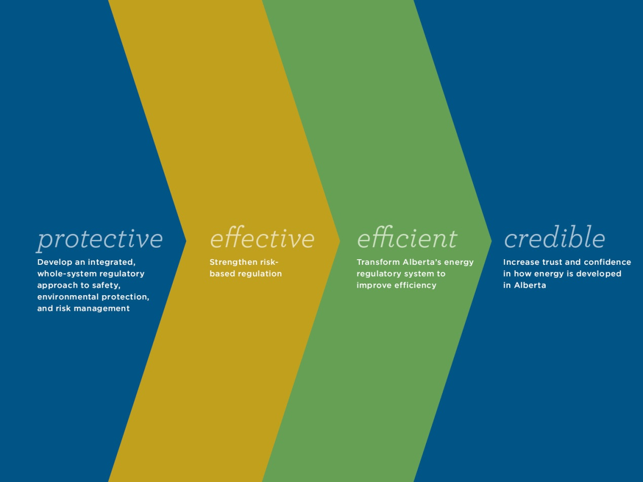
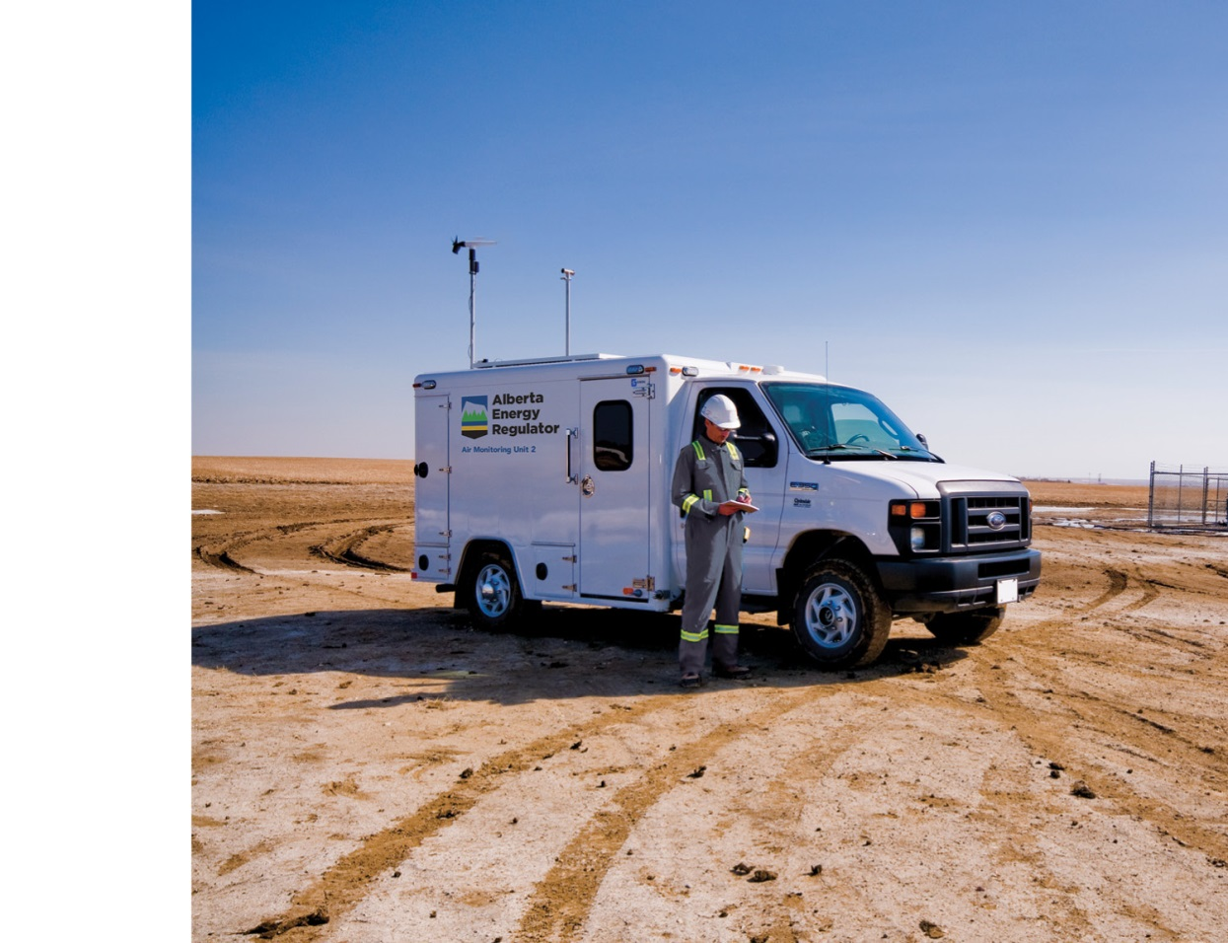
Where We are Going

Slide 12
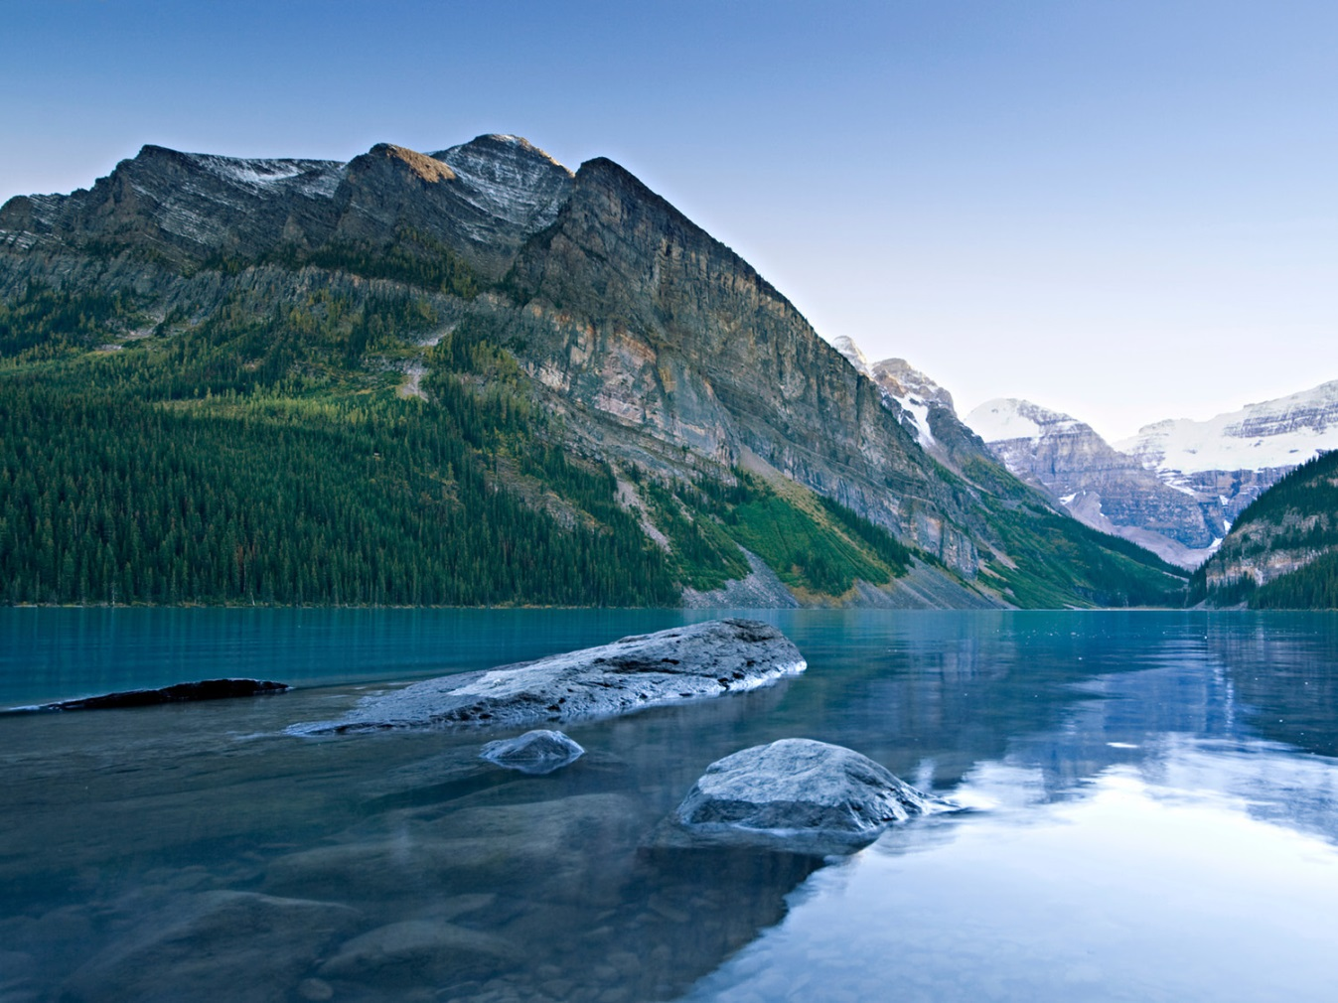
Why Regulatory Excellence?
Public confidence
Proactive leadership
Manage risk
Embrace opportunity

Slide 13
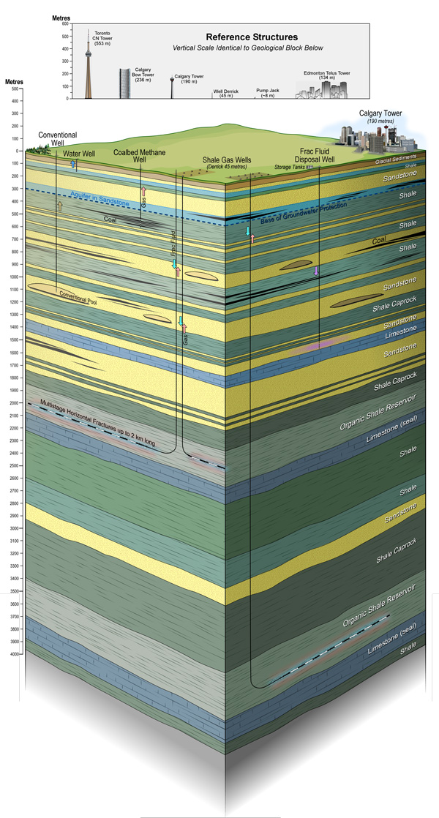
Key Initiatives
Protective
Peace River odors
Methane emission reduction
Induced seismicity
Effective
Pipeline safety
ABR

Slide 14
Key Initiatives
Efficient
Single application, review, decision
NTAP
Credible
Regulatory Excellence
CoRE
Performance reporting
Outreach

